Slide 1
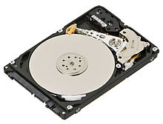
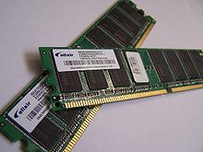
V, F, IMC, IDA
Extract, Transform, Load (ETL) Process
Transform
Extract
Load
Source
Target
Disk Drive
Slower
Less expensive
Memory
Faster
More expensive

Slide 2
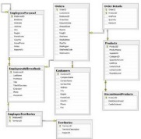
Data Virtualization
Data Virtualization
Data stored at each source, but looks like it’s in one place
Source A
Source C
Virtualized Database
Source B
Source D

Slide 3
Data Virtualization
Data Virtualization: Advantages
Reduces duplication & storage needs
Changes reflected immediately
Assess layer easier to change
Data Virtualization: Limitations
Adds a processing layer; can slow down extraction
Doesn’t necessarily make sense of how data is related

Slide 4
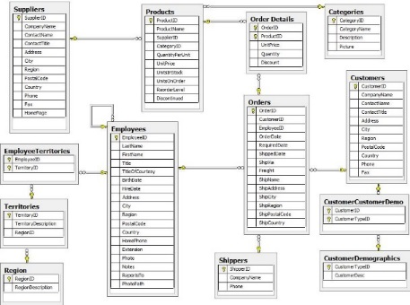
Data Federation
Data Federation
Data stored at each source, but looks like it’s in one place
Also fits data into a common data model
Additional benefit of a more integrated view, but adds even more processing that can further slow down extraction
Source A
Source C
Federated Database
Source B
Source D
Common Data Model

Slide 5
Data Virtualization & Federation
More attractive when:
Resourced limited
Velocity of change is rapid
Little transformation or integration required
Sources of high quality with lots of history
Less attractive when:
Volume or complexity is high
Historical data needs to be stored outside of source

Slide 6
In-Memory Computing & In-Database Analytics
In-Memory Computing
Data loaded into RAM
Enables faster access and more rapid iteration
Initial load can take some time
In-Database Analytics
Moves analytical operations back into the database
Enables rapid & automated application of analytics
Ideal in highly time-sensitive environments

Slide 7
Recap
Data Virtualization
Data Federation
In-Memory Computing
In-Database Analytics

